Slide 1
The ADT List
Notes:
This lecture introduces the concept of the ADT List. - But first, let’s review at the ADT Bag.

Slide 2




The ADT List
The ADT Bag
Collection of items
No order to items
Items are in bag or not in bag
The ADT List
Collection of items
Items have a position or order in the list
List
First Location
Position 1
Grocery List
Apples
Oranges
Pears
Tomatoes
Bread
Tea
Chicken Legs
Steak Cuts
Cheddar Cheese
Nachos
1
2
3
4
5
6
7
8
9
10
Bag
Last Location
Position 10
Notes:
This lecture introduces the concept of the ADT List. - But first, let’s review at the ADT Bag.
The bag is a collection of items that don’t have any order. Items are simply in the bag or they’re not in the bag.
@@ A list provides a way to organize data. We can have to-do lists, gift lists, address lists, grocery lists, even lists of lists. These lists provide a useful way for us to organize our lives.
@@ Each list has a first item,
@@ a last item, and usually items in between. That is, the items in a list have a position: first, second, and so on. An item’s position might be important to you, or it might not. When adding an item to your list, you might always add it at the end, or you might insert it between two other items already in the list.
When you work with a list, you determine where an entry is or should be. You probably are not conscious of its exact position: Is it tenth? Fourteenth? However, when your program uses a list, a convenient way to identify a particular entry is by the entry’s position within the list. It could be first, that is, at position 1, or second (position 2), and so on. This convention allows you to describe, or specify, the operations on a list more precisely.

Slide 3


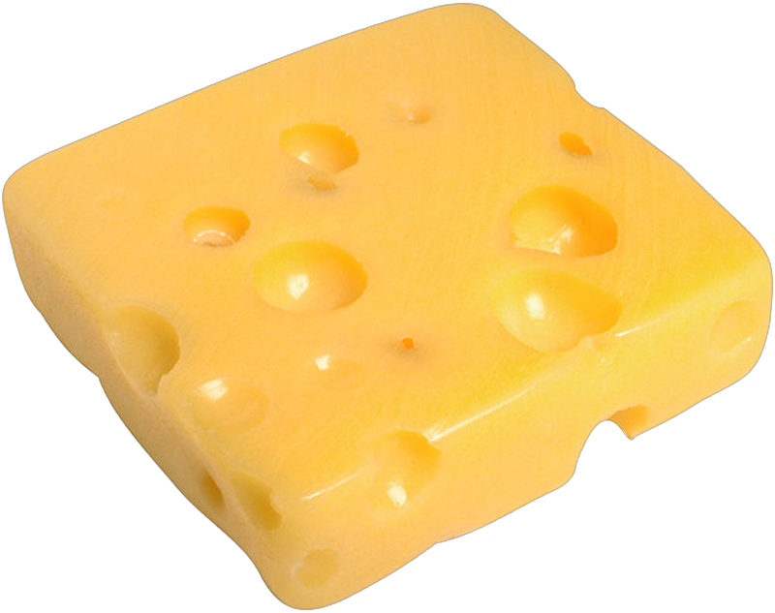

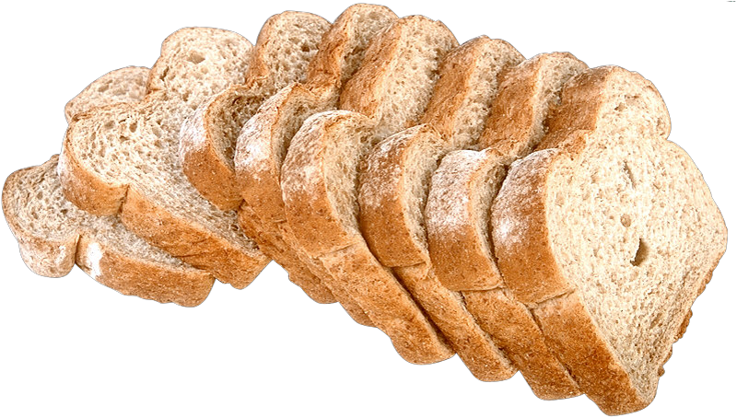
The ADT List
How a List behaves . . .
adding items
adding items at a specified position
insert
Tomatoes at position 4
insert
Oranges at position 2
insert
Apples at position 1
insert
Cheese at position 3
insert
Bread at position 1
insert
Nachos at position 4
Grocery List
Apples
Oranges
1
2
3
4
5
6
7
8
9
10
Bread
Cheese
Tomatoes
Cheese
Tomatoes
Nachos
Notes:
Everyday lists such as to-do lists, gift lists, address lists, and grocery lists have entries that are strings. What can you do with lists like this?
Typically, we add a new item at the end of the list. For example, when making our grocery list,
@@ we might simply write down items as they came to mind.
For example Apples,
@@ oranges,
@@ cheese and
@@tomatoes
Actually, we can add a new item anywhere: at the beginning, the end, or in between items.
@@ We might want to place bread at the first position so that we don’t forget it
@@ and move each of the other items down one position.
@@ we may want to add nachos to the list next to the cheese
@@ since we may want to buy these together.
@@ [slide] You can cross out an item—that is, remove it.

Slide 4

The ADT List
How a List behaves . . .
adding items
adding items at a specified position
remove an item at a specific location in the list
replace an item in the list
remove, then insert
look at the entry at a specified position
count the number of items in the list
see whether the list is empty
remove all the items from the list (clear)
replace
item at position 4 with Low-Fat Cheese
remove
item at position 3
Grocery List
Grocery List
1
2
3
4
5
6
7
8
9
10
Bread
Apples
Low-Fat Cheese
Oranges
Nachos
Cheese
Tomatoes
Notes:
For example if we remember that we have oranges at home and don’t need to buy more.
@@After removing an item, each of the items in the list move up a position.
@@ We can replace an item in the list
@@ so that if we decide to want to purchase low-fat cheese for our nachos, we can make that change.
Some of the other actions we can take with our list are
@@ looking at any item. @@ counting the number of items in the list. @@ checking whether the list is empty.
@@ and removing all the items or clearing the list.

Slide 5
The Abstract Class List Interface
Position oriented data structure
List positions begin at 1
Can add entries at positions from 1 to n+1
Can remove entries at positions from 1 to n
template<class ItemType>
class ListInterface
{
public:
/** Sees whether this list is empty. */
virtual bool isEmpty() const = 0;
/** Gets the current number of entries in this list. */
virtual int getLength() const = 0;
/** Inserts an item into this list at a given position. */
virtual bool insert(int position, const ItemType& someItem) = 0;
/** Deletes the entry at a given position from this list. */
virtual bool remove(int position) = 0;
/** Removes all entries from this list. */
virtual void clear() = 0;
/** Gets the entry at the given position in this list. */
virtual ItemType getEntry(int position) const = 0;
/** Replaces the entry at the given position in this list. */
virtual bool setEntry(int position, const ItemType& someItem) = 0;
/** Destroys object & frees memory allocated by object. */
virtual ~ListInterface() { }
}; // end ListInterface
Notes:
To specify the ADT list interface, we describe its data and specify the operations on that data. The ADT list interface is general and has entries that are objects of the same type - ItemType - that will chosen by our client . The following is an initial specification of the ADT list interface:
The ADT List is a position oriented data structure. That means that we access entries based on there location in the list. Just like your shopping list, our list positions begin at 1 (how often has your shopping list had an item in position zero?)
@@ So the entries in a list of n entries are numbered from 1 to n. Although you cannot add a new entry at position 0, you can add one at position1 or at position n + 1. or anywhere in between
@@ You can only remove items from positions that have entries, therefore you can only remove entries at positions from 1 to n

Slide 6
Using The ADT List

Slide 7
The ADT List Characteristics
First Location
Head
No Predecessor
Items are referenced by position in list
Each item has
a unique predecessor
a unique successor
Grocery List
Apples
Oranges
Pears
Tomatoes
Bread
Tea
Chicken Legs
Steak Cuts
Cheddar Cheese
Nachos
1
2
3
4
5
6
7
8
9
10
Last Location
Tail
No Successor

Slide 8
Specifying ADT Operations
How a List behaves . . .
adding items
adding items at a specified position
remove an item at a specific location in the list
replace an item in the list
remove, then insert
look at the entry at a specified position
count the number of items in the list
see whether the list is empty
remove all the items from the list (clear)
Define operation contract for the ADT list
Do not specify:
how to store the list items
how to perform the operations

Slide 9
Specifying ADT Operations
class ListInterface
{
public:
virtual bool isEmpty() const = 0;
virtual int getLength() const = 0;
virtual bool insert(int position, const ItemType& someItem) = 0;
virtual bool remove(int position) = 0;
virtual void clear() = 0;
virtual ItemType getEntry(int position) const = 0;
virtual ~ListInterface() { }
}; // end ListInterface
template<class ItemType>
class ListInterface
{
public:
/** Sees whether this list is empty. */
virtual bool isEmpty() const = 0;
/** Gets the current number of entries in this list. */
virtual int getLength() const = 0;
/** Inserts an entry into this list at a given position. */
virtual bool insert(int position, const ItemType& someItem) = 0;
/** Deletes the entry at a given position from this list. */
virtual bool remove(int position) = 0;
/** Removes all entries from this list. */
virtual void clear() = 0;
/** Gets the entry at the given position in this list. */
virtual ItemType getEntry(int position) const = 0;
/** Destroys object & frees memory allocated by object. */
virtual ~ListInterface() { }
}; // end ListInterface
Define operation contract for the ADT list
Do not specify:
how to store the list items
how to perform the operations
Notes:
This lecture presents an example of using the ADT List.
Here is the list interface we developed in our previous lecture.
@@ Let’s remove the comments to save some screen space so we can keep this handy during our examples.

Slide 10

Using the ADT List
class ListInterface
{
public:
virtual bool isEmpty() const = 0;
virtual int getLength() const = 0;
virtual bool insert(int position, const ItemType& someItem) = 0;
virtual bool remove(int position) = 0;
virtual void clear() = 0;
virtual ItemType getEntry(int position) const = 0;
virtual ~ListInterface() { }
}; // end ListInterface
Grocery List
auto groceryList = std::make_shared<SomeList<std::string>>();
groceryList->insert(1, "Apples");
groceryList->insert(2, "Oranges");
groceryList->insert(3, "Cheese");
groceryList->insert(4, "Tomatoes");
groceryList->insert(1, "Bread");
groceryList->insert(4, "Nachos");
1
2
3
4
5
6
7
8
Apples
Oranges
Cheese
Tomatoes
Bread
Cheese
Tomatoes
Nachos

Slide 11

Using the ADT List
class ListInterface
{
public:
virtual bool isEmpty() const = 0;
virtual int getLength() const = 0;
virtual bool insert(int position, const ItemType& someItem) = 0;
virtual bool remove(int position) = 0;
virtual void clear() = 0;
virtual ItemType getEntry(int position) const = 0;
virtual ~ListInterface() { }
}; // end ListInterface
The list contains 5 entries, as follows:
Bread is entry 1
Apples is entry 2
Nachos is entry 3
Low-Fat Cheese is 4
Tomatoes is 5
Grocery List
auto groceryList = std::make_shared<SomeList<std::string>>();
groceryList->insert(1, "Apples");
groceryList->insert(2, "Oranges");
groceryList->insert(3, "Cheese");
groceryList->insert(4, "Tomatoes");
groceryList->insert(1, "Bread");
groceryList->insert(4, "Nachos");
groceryList->remove(4);
groceryList->setEntry(4, “Low-Fat Cheese”);
int numberOfEntries = groceryList->getLength();
std::cout << "The list contains " << numberOfEntries;
std::cout << " entries, as follows:" << std::endl;
for (int position = 1; position <= numberOfEntries; position++)
std::cout << list->getEntry(position) <<" is entry "<<position<<std::endl;
1
2
3
4
5
6
7
8
Bread
Apples
Oranges
Nachos
Cheese
Low-Fat Cheese
Tomatoes

